Slide 1

Project Title
Notes:
Image generated by chatgpt - reference

Slide 2

Meet the team
David Lynn
Alice Schulz
Jinglei Xiang
Cheng Hu
Qing Zheng

Slide 3
Stakeholders
NBA
Teams
Commercial entities (sponsors, broadcasters etc.)
Fans
Notes:
125 players from 43 countries
$76 billion TV rights
League revenue $11.3 billion
Average team value $4.4 billion
NBA (presumably) wants close games, excitement etc.

Slide 4
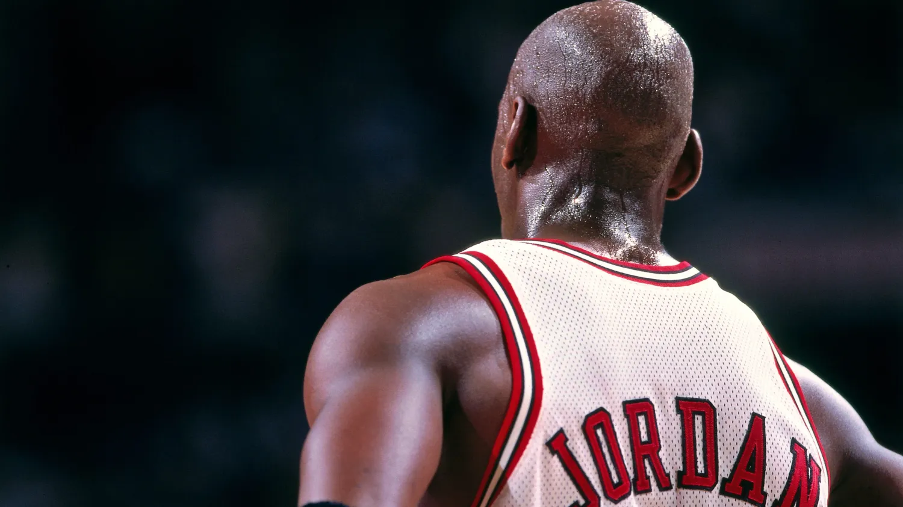
It’s better to shoot and miss, then to let time run out and wonder what if.
Notes:
If riskier / further shots late in game question used.
Photo source: https://andscape.com/features/during-the-last-dance-ill-remember-how-michael-jordan-brought-me-closer-to-the-most-important-man-in-my-life/

Slide 5
Data Quality
Collection
How collected
Dataset source reliability
datasets
Missing or incomplete data
Reliability / Veracity
Relationships between datasets

Slide 6
Data Quality
COLLECTION
Datasets
Collection methods
DATASET
Missing or incomplete data
Reliability / Veracity
Relationships between datasets

Slide 7
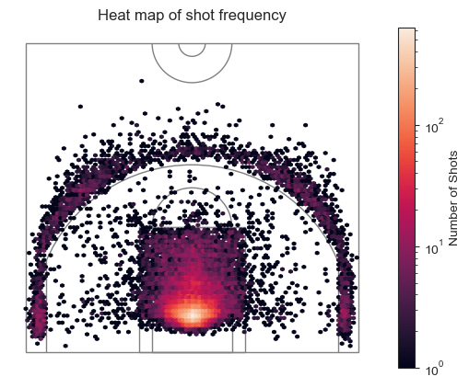
Notes:
Heatmap

Slide 8
Research Questions
Shot Success
Shot Distance
Score
Anticipated method?

Slide 9
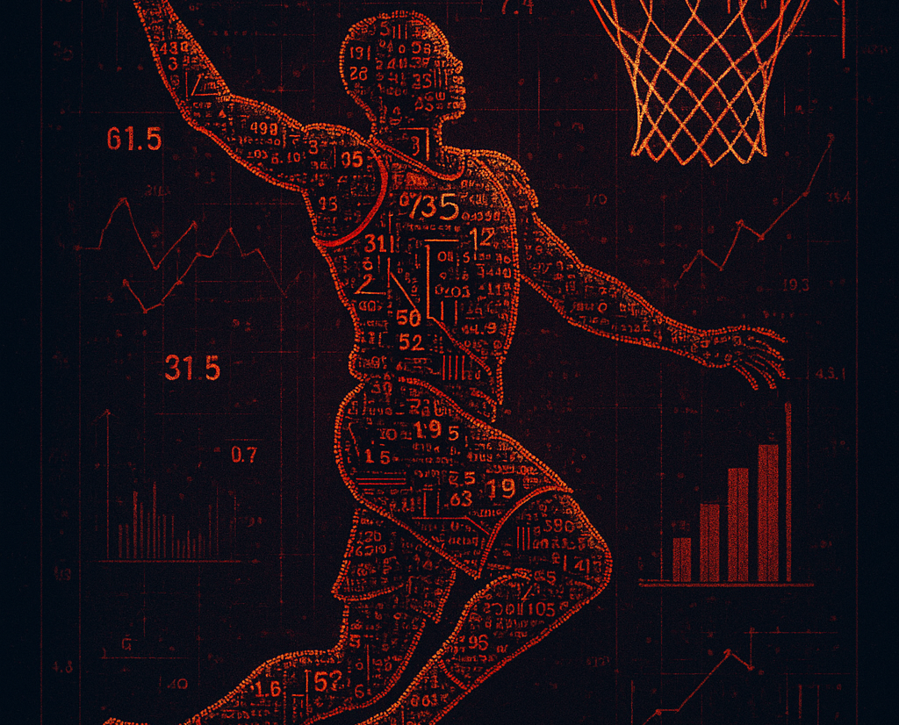
Thank you

Slide 10
References
1. xxxx

Slide 11
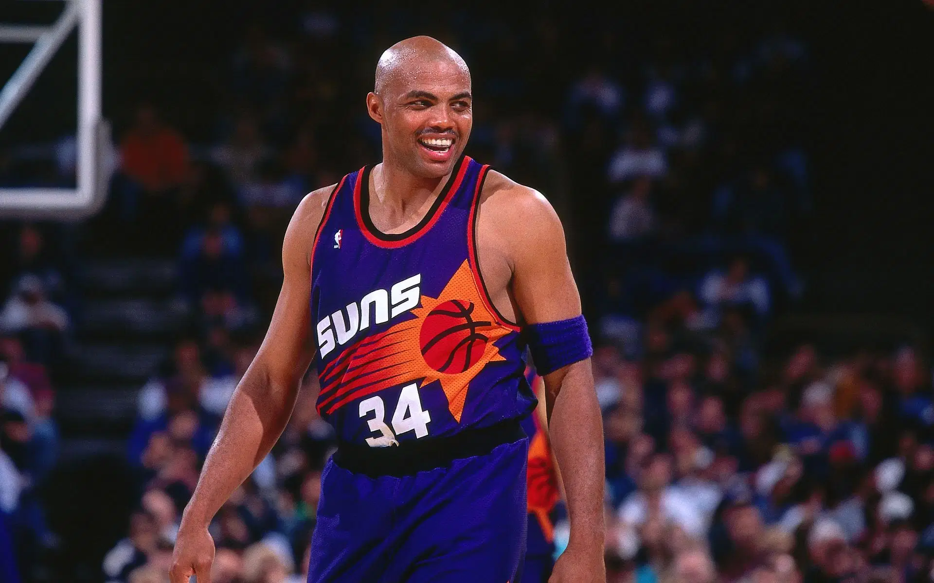
The only difference between a good shot and a bad shot is if it goes in or not
Notes:
https://www.sportskeeda.com/basketball/news-i-said-who-s-better-me-said-that-motherf-ker-right-there-charles-barkley-sick-people-telling-14-time-all-star-better

Slide 12

purpose
Introduction
Building confidence
Engaging the audience
Visual aids
Final tips & takeaways

Slide 13

THE POWER OF COMMUNICATION

Slide 14

OVERCOMING NERVOUSNESS
Confidence-building strategies

Slide 15

OVERCOMING NERVOUSNESS
Techniques for connecting
Make eye contact with your audience to create a sense of intimacy and involvement
Weave relatable stories into your presentation using narratives that make your message memorable and impactful
Encourage questions and provide thoughtful responses to enhance audience participation
Use live polls or surveys to gather audience opinions, promoting engagement

Slide 16
OVERCOMING NERVOUSNESS
Confidence-building strategies

Slide 17
Final tips & takeaways
Continue improving
Seek feedback
Reflect on performance
Explore new techniques
Set personal goals
Iterate and adapt
PRACTICE MAKES PERFECT
Consistent rehearsal
Strengthen your familiarity
Refine delivery style
Pacing, tone, and emphasis
Timing and transitions
Aim for seamless, professional delivery
Practice audience

